Slide 1
Fourier series
Let f(x) be defined in the interval (-L,L) and determined outside of this interval by f(x+2L) = f(x), i.e. assume that f(x) has the period 2L. Then the Fourier series or Fourier expansion corresponding to f(x) is defined to be
Even Part
Odd Part

Slide 2
Coefficients
For any real number c , a_{n} and b_{n} can be determined equivalently as

Slide 3
Graph the following functions
period
3
-15
-10
-5
5
10
15
-3
period

Slide 4
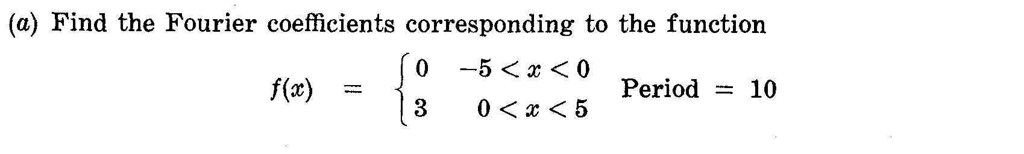
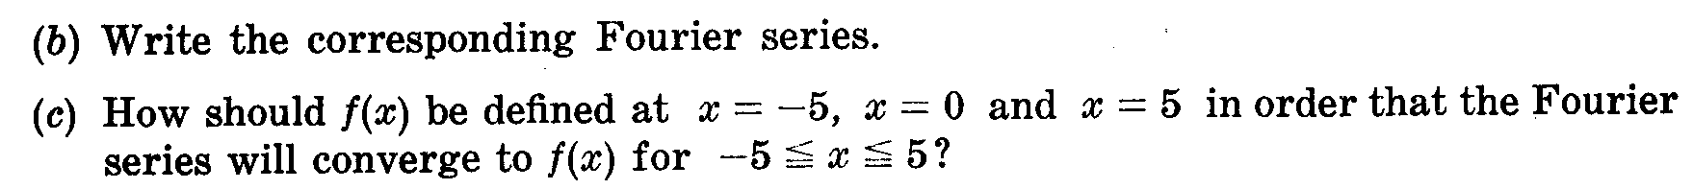
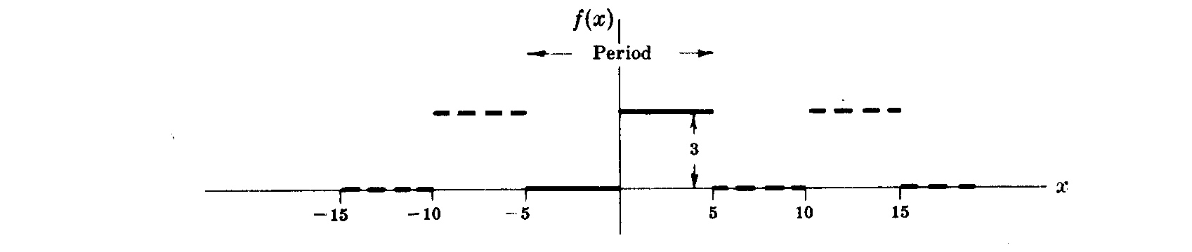

Slide 5
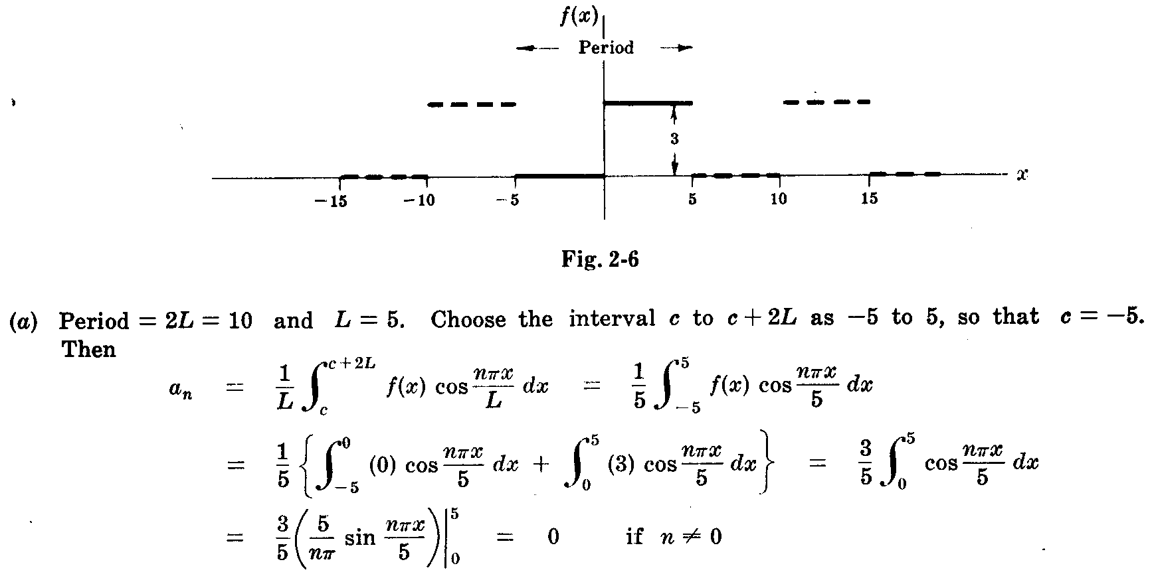

Slide 6
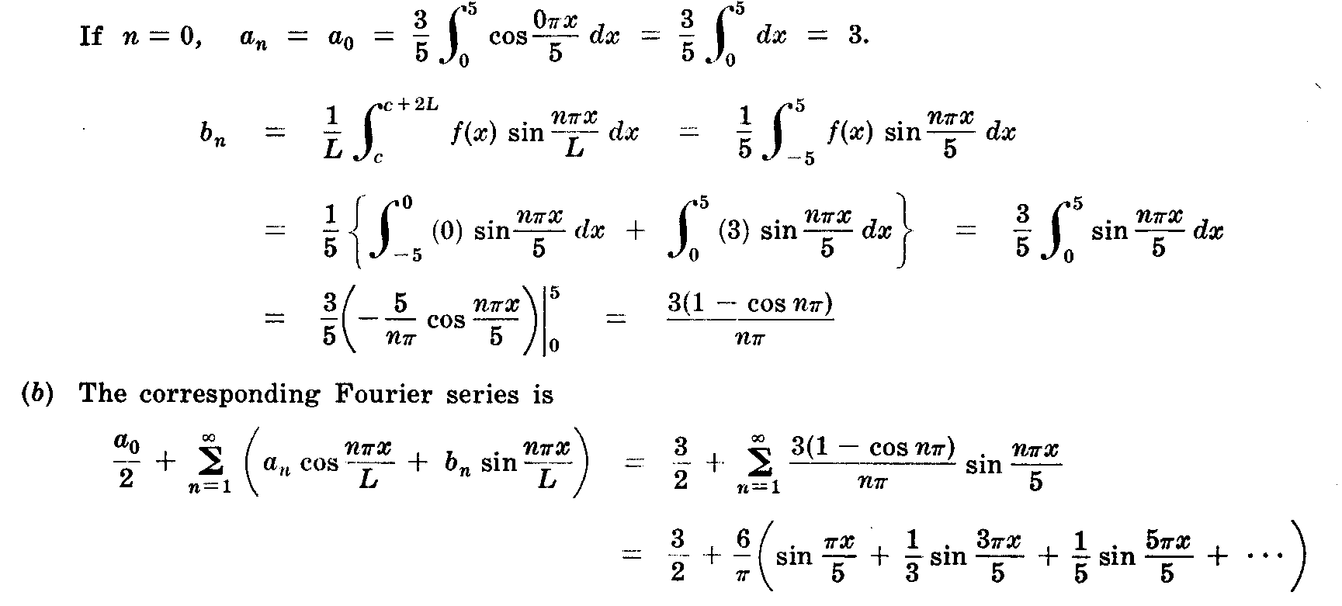

Slide 7
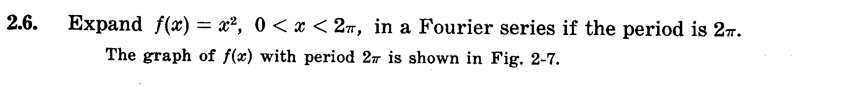
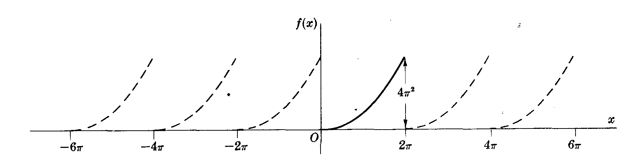
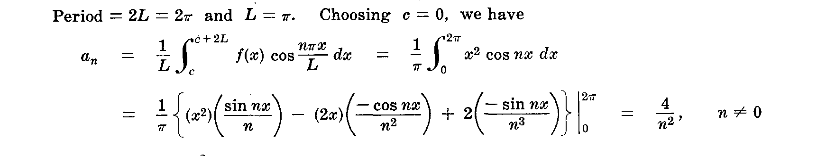

Slide 8
